Slide 1
School of Information Technology
ICT302
Information Technology Professional Practice Project
ITP3
Design

Slide 2
Acknowledgement
of Country
We acknowledge that Murdoch University is situated on the lands of the Whadjuk and Binjareb Noongar people.
We pay our respect to their enduring and dynamic culture and the leadership of Noongar elders past and present.
The boodjar (country) on which Murdoch University is located has for thousands of years, been a place of learning. We at Murdoch University are proud to continue this long tradition.
Notes:
South Street
We acknowledge that Murdoch University is situated on the lands of the Whadjuk and Binjareb Noongar people.
We pay our respect to their enduring and dynamic culture and the leadership of Noongar elders past and present.
The boodjar (country) on which Murdoch University is located has for thousands of years, been a place of learning. We at Murdoch University are proud to continue this long tradition.

Slide 3
What is a Design Document?
The design document is your blueprint for building the information system (IS) or consultancy and should provide a clear picture of the processes involved
It acts as a reference for the system
It aids in the distribution of development among developers and other teams
If the system is destroyed, it should be able to be rebuilt using this document
Design is not coding, design is design!
Notes:
3

Slide 4
Introduction
What is a Design Document?
The design document is your blueprint for building the information system (IS) or consultancy and should provide a clear picture of the processes involved
It acts as a reference for the system
It aids in the distribution of development among developers and other teams
If the system is destroyed, it should be able to be rebuilt using this document
Design is not coding, design is design!

Slide 5
Design Basics
Exactly what should be done during the design phase depends on:
The size of the system to be implemented
The complexity of that system
The arrangement of the design and implementation teams
The chosen design methodology
Any requirements for documentation

Slide 6
Design Document
The design document includes the following
major design components:
Data design
Process/Procedural design
Architecture/Infrastructure design
Interface design

Slide 7
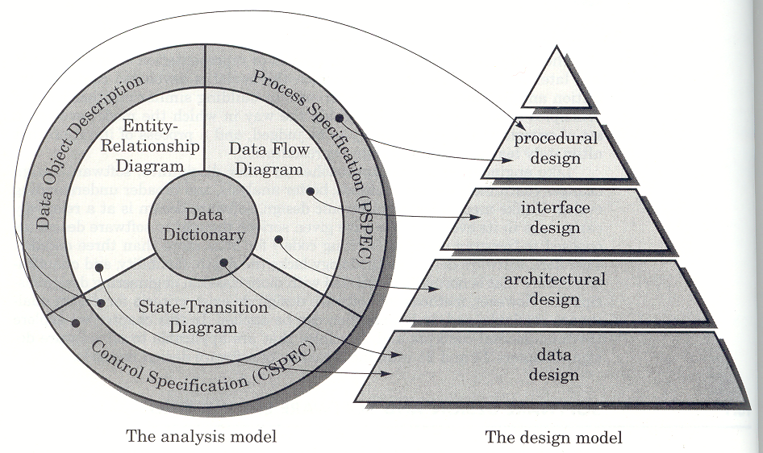
Design Process

Slide 8
1. Data Design
Data design means to:
Expand and develop data objects
Identify all data structures and their operations
Create a full data dictionary
Perform database design (ERD)
Data-to-Process CRUD Matrix if applicable
Recall that CRUD means Create-Read-Update-Delete

Slide 9
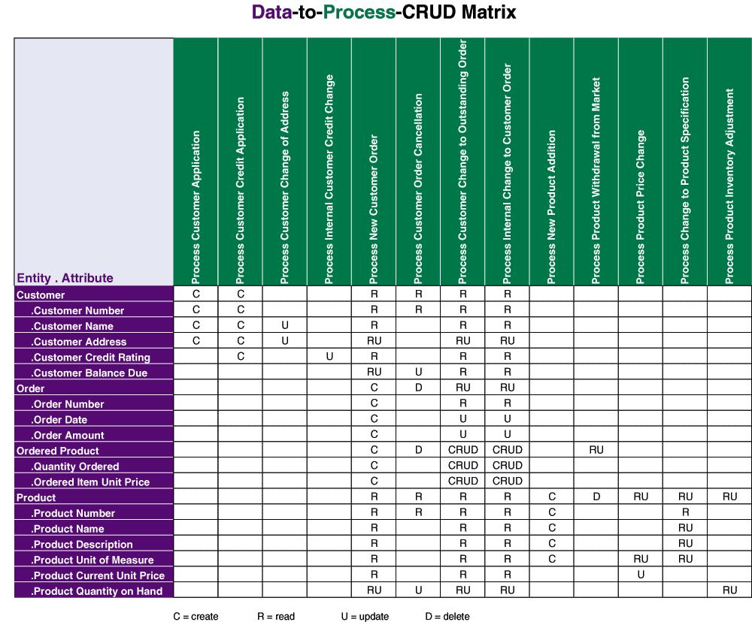
Data to Process CRUD Matrix
Notes:
9

Slide 10
2. Process/Procedural Design
Provide details of all procedures and processes:
Detailed description of each software component
Process models such as detailed Data Flow Diagrams:
Traditional: context DFD - level 0, level 1, level 2, etc
Event-driven: context DFD - decomposition diagram, event response diagrams, use case lists, etc
Transition State Diagrams

Slide 11
Process/Procedural Design
Process descriptions (using structured English), expanded use-case narratives (if not already done), possibly decision tables
Data flows defined in the data dictionary using data structures

Slide 12
Structured English Example
1. For each CUSTOMER NUMBER in the data store CUSTOMERS:
a. For each LOAN in the data store LOANS that matches the above
CUSTOMER NUMBER:
1) Keep a running total of NUMBER OF LOANS for the
CUSTOMER NUMBER.
2) Keep a running total of the ORIGINAL LOAN PRINCIPAL for the
CUSTOMER NUMBER.
3) Keep a running total of CURRENT LOAN BALANCE for the
CUSTOMER NUMBER.
4) Keep a running total of AMOUNTS PAST DUE for the
CUSTOMER NUMBER.
b. If the TOTAL AMOUNTS PAST DUE for the CUSTOMER NUMBER
is greater than $100.00 then:
1) Write the CUSTOMER NUMBER and all their data attributes
as described in the data flow LOANS AT RISK.
Else
1) Exclude the CUSTOMER NUMBER and data from the data
flow LOANS AT RISK.
Notes:
12

Slide 13
Process/Procedural Design
Include algorithms, as well as an overview of the components using structure charts, hierarchy charts, etc.
If using object oriented modelling or programming you will need design class diagrams, design sequence diagrams & design use cases:
Either high-level diagrams with a data dictionary, or
Low-level diagrams which include all the definitions

Slide 14
3. Architecture/Infrastructure Design
Define the architecture of the system
Provide an architectural diagram (this can
include the structure of static web pages)
Additional software components as necessary
Infrastructure requirements (see next slide)
Discuss alternative designs – if applicable

Slide 15
Architecture/Infrastructure Design
Infrastructure requirements:
Capacity: data volumes, transaction volumes, number of users, etc
Performance: on-line response times, print speeds, etc
Integration and compatibility: interface with or supported by existing systems
Platform strategy: platform to be used

Slide 16
Architecture/Infrastructure Design
Infrastructure requirements (cont):
Security: requirements that may constrain your technical options
Back-up & recovery: protection of all systems
Scalability: how your system can be expanded if needed
Future proofing: how will your system cope in the future (generally a balance of leading-edge technology vs. modest implementation)

Slide 17
Computing Layers
Any IS application can be mapped to 5 conceptual layers, with different implementation options possible for the layers:
Presentation layer: the user interface
Presentation layer logic: such as input editing
Application logic layer: the business rules, policies, and procedures
Data manipulation layer: to store and retrieve data to and from a database
Data layer: the actual business data
Notes:
17

Slide 18
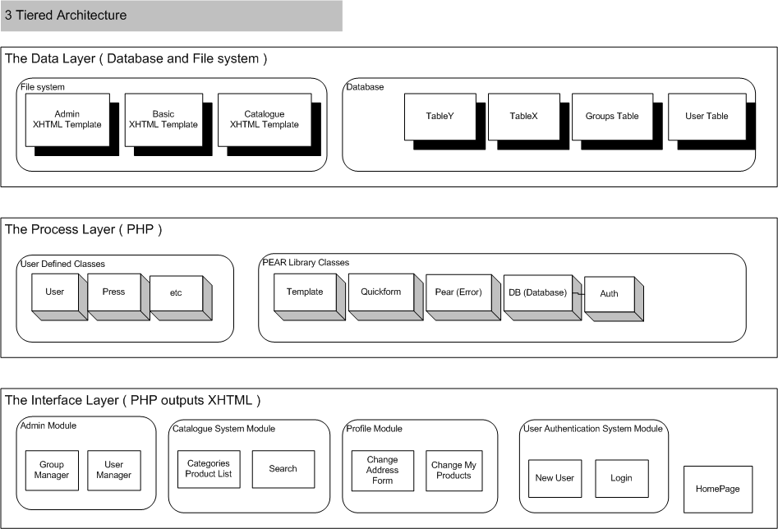
Architectural Diagram

Slide 19
4. Interface Design
“The goal of the user interface is to make the interface vanish.”
“A user interface is well-designed when the program behaves exactly how the user thought it would.”
Joel Spolsky, User Interface Design For Programmers (1999)
www.joelonsoftware.com/uibook/fog0000000249.html

Slide 20
User Interface Design Commandments
Understand your users and their tasks
Involve the user in interface design
Test the system on actual users
Practice iterative design
Create a system that is both useable and useful
Notes:
20
No additional notes.

Slide 21
Causes of Interface Problems
Excessive use of computer jargon and acronyms
Obscure or counter-intuitive design
Inability to distinguish between alternative actions (“what do I do next?”)
Inconsistent problem-solving approaches
Design inconsistency
Notes:
21

Slide 22
HCI Design Guidelines
General Interaction:
Be consistent
Offer meaningful feedback
Permit easy reversal of actions
Reduce the amount of information to memorize
Appropriate layout
Context sensitive help

Slide 23
HCI Design Guidelines
Display information relevant to the current context
Use minimal information
Consistent labels, layout, abbreviations, colors, etc.
Produce meaningful error messages
Use windows to compartmentalize different types of information

Slide 24
Dialogue Guidelines
Tone:
Use simple, grammatically correct sentences
Don’t try to be funny or cute
Don’t be condescending
Notes:
24

Slide 25
Dialogue Guidelines
Terminology:
Omit needless words
Don’t use computer jargon
Avoid most abbreviations
Use simple terms
Be consistent in your use of terminology
Carefully phrase instructions—use appropriate action verbs
“Type your name”, not “Enter your name”
Notes:
25

Slide 26
Designing for
Experts vs. Novices
Expert user
Include fast track paths for tasks
Novice user
Break tasks into small steps / chunks
Allow for additional assistance
Notes:
26

Slide 27
User Interface Design Process
Plan and document the user interface dialogue:
Written descriptions following flow of events
Sketches of screens
Storyboarding – showing sequence of sketches of display screen during a dialog
State diagrams
Use case narratives
UML diagrams – including activity and system sequence diagrams
Notes:
27
No additional notes.

Slide 28
User Interface Design Process
Prototype the dialogue and user interface
Obtain user feedback
Early and often
Usability
Notes:
28
No additional notes.

Slide 29
Output Design Guidelines
Outputs should be simple to read and
interpret:
Every output must have a title
Every output should be time and date stamped
Reports and screens should include headings
Fields and columns should be clearly labeled
Reports should include legends for all abbreviations
Use information hiding to expand and contract information
Notes:
29

Slide 30
Output Design Guidelines
Information should be balanced across the page or screen
Provide for easy navigation within information
Avoid computer jargon
Outputs must be acceptable to the system users who will receive them
Notes:
30

Slide 31
Input Design Considerations
Designing data input needs to consider:
Data capture - the identification and acquisition of new data (at its source)
Source document is a paper-based form used to record data that will eventually be entered into the system
Data entry – converting to a computer readable format
Data processing – eg: batch, remote batch, online
Notes:
31

Slide 32
Input Design Considerations
General Principles:
Input should be as simple as possible and designed to reduce the possibility of error
Capture only variable data
Do not capture data that can be calculated or stored in computer programs as constants
Notes:
32

Slide 33
Input Design Considerations
Source Document / Form Design Guidelines
Make source documents easy to fill out:
Include instructions for completing the form
Use well designed flow. Data to be entered (keyed) should be sequenced so that it can be read like a book, that is, top-to-bottom and left-to-right
When possible, base input design on known metaphors
Notes:
33

Slide 34
GUI Components
You should have an understanding of the purpose, advantages and disadvantages of GUI controls so that you can make decisions about which controls should be used for each data attribute that will be input
Text boxes - When the input data values are unlimited in scope
Radio buttons - When data has limited predefined set of mutually exclusive values
Check boxes - When the value set consists of a simple yes or no value
List boxes - When data has a large number of possible values
Notes:
34

Slide 35
GUI Components
Drop down lists - When data has large number of possible values and screen space is too limited for a list box
Combination boxes - Providing the user with the option of selecting a value from a list or typing a value that may or may not appear in the list
Spin boxes - When the user needs to navigate through a small set of choices or directly typing a data value
Notes:
35

Slide 36
Summary
What is the Design document
Design basics
Data design
Process design
Architectural design
Interface design

Slide 37
Peter Cole
p.cole@Murdoch.edu.au
0417 097 914

